Slide 1

Project O.R.C.A
On-water Rubbish Collection robot with Automated Sensing
PROJ324 - Luke Waller
Third Year MEng Robotics
Notes:
Hello, My name is Luke Waller and this is my PROJ324 submission video on project O.R.C.A, the on water rubbish collection robot with automated sensing

Slide 2
Inspiration for the project
Standing bodies of water are continually getting more polluted and this is all ending up in the ocean.
Pollution in the sea is increasing at a rate of 10 million tonnes each year.
Studies suggest by 2050 the amount plastic in the sea will outnumber the number of fish.
Over 500 dead zones where marine life cannot live.
Notes:
So, what was the inspiration of this project?

Slide 3
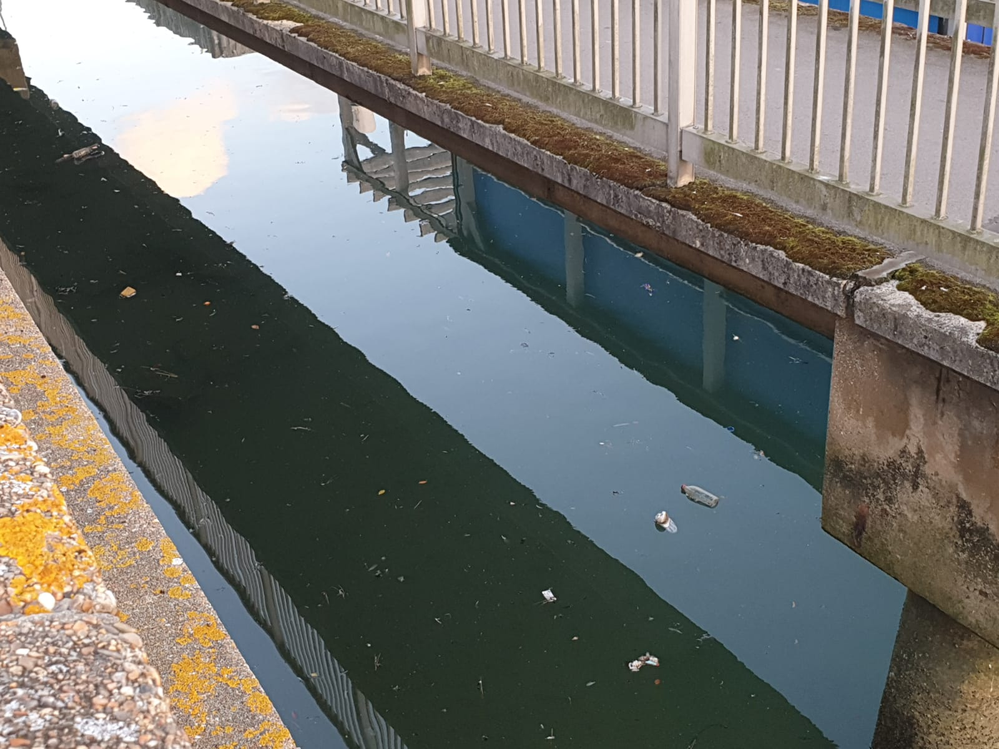
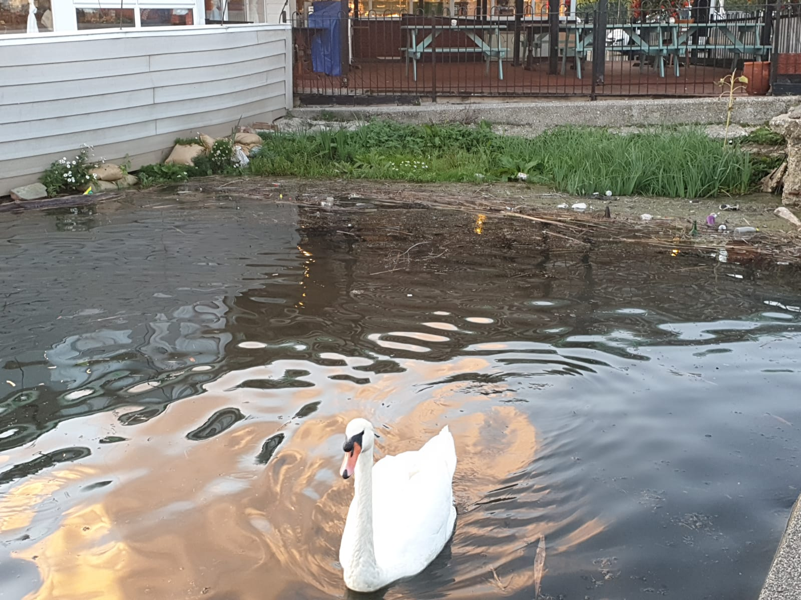
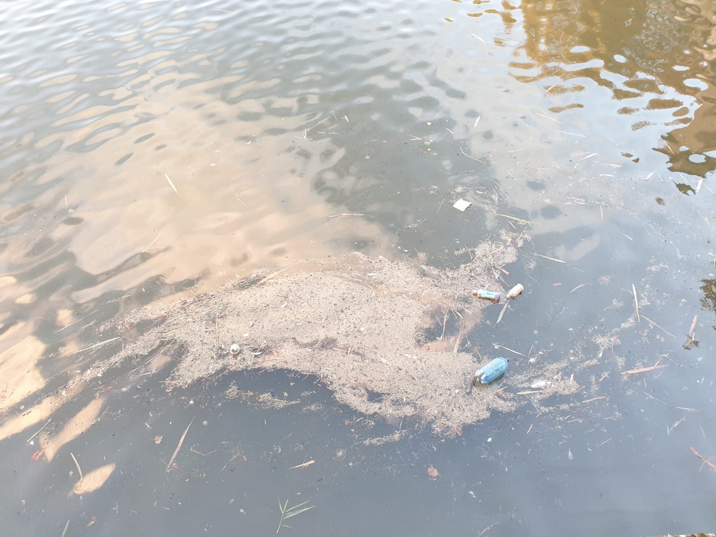
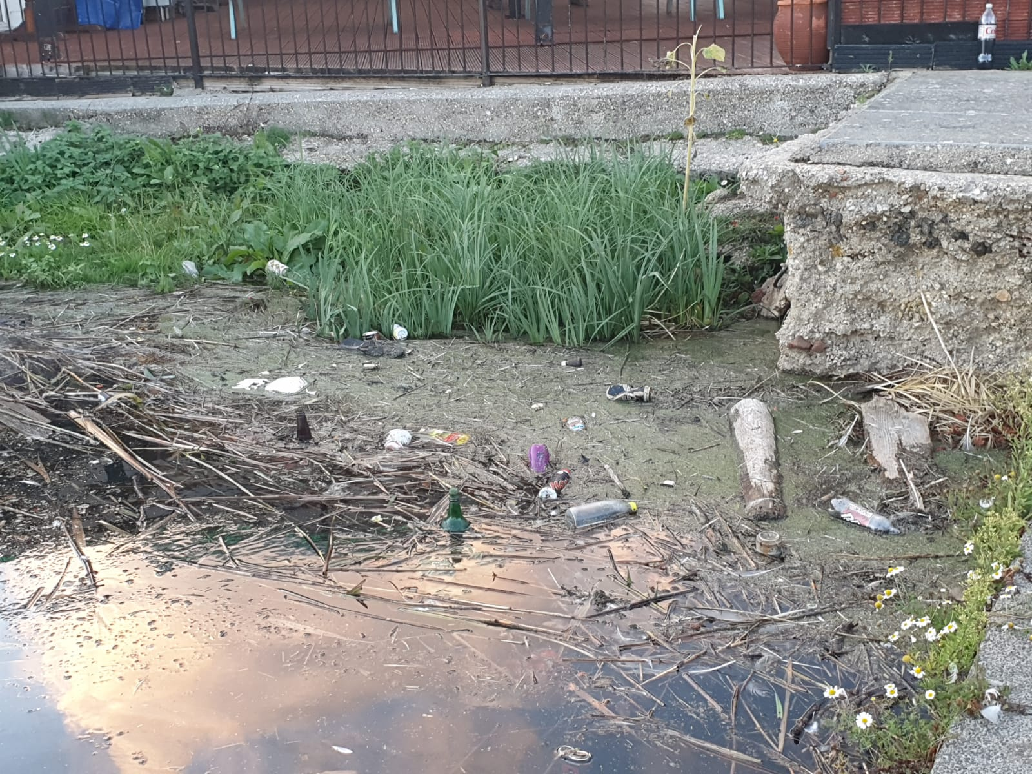
Local images of reservoir in Weymouth
This was one of the biggest inspirations for the project
Lived near this reservoir for over 20 years
Local wildlife lives among it

Slide 4
Initial Project Aims
Create a boat that can float on water
Use a mechanism to scoop/collect the litter
Create a control system for the craft that will allow it to be remotely operated

Slide 5
Project Context – Project Aims
Create a surface-litter cleaning robot for still and slow-moving expanses of water such as a canal, lake, or harbour.
Broken into 5 deliverables
Design and create a boat that is capable of floating on water and being controlled
Design and create a suitable litter collection system that can collect litter on the surface of water
Combine the litter collection system with the main hull of the boat
Implement a custom microcontroller based remote control and receiver
Add sensors to monitor battery levels and litter collection status

Slide 6
Hardware Design
Initial Designs
Boat Design
Conveyor Design
Finalised Design

Slide 7
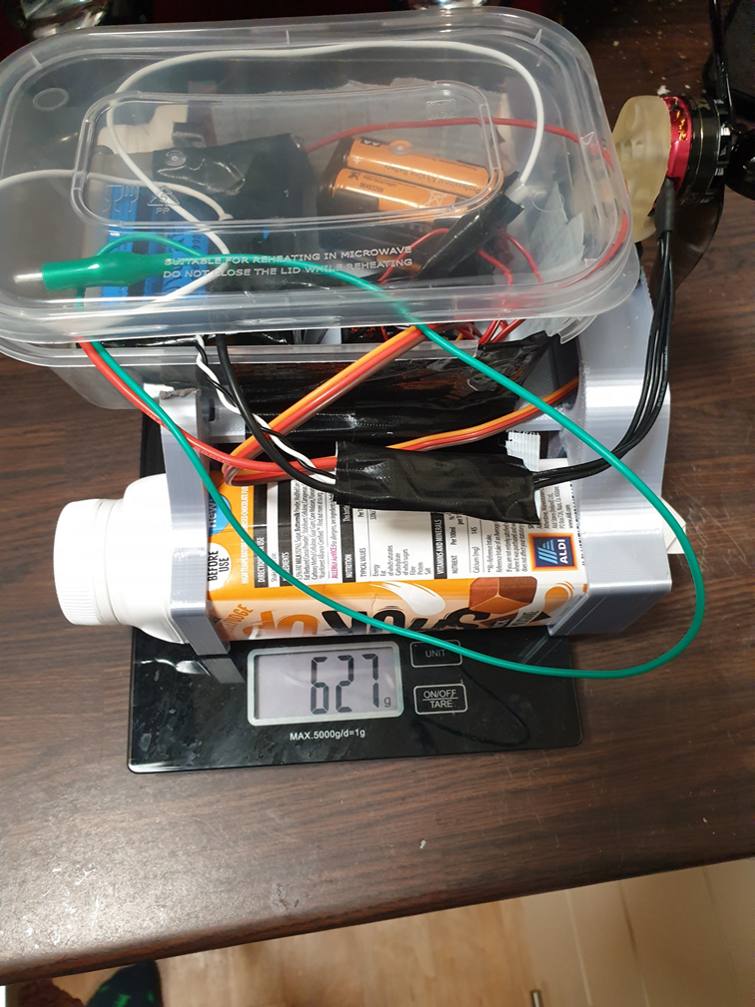
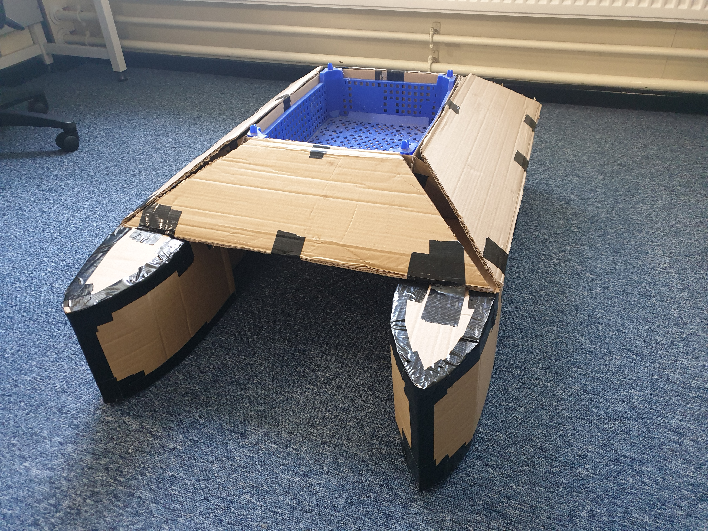
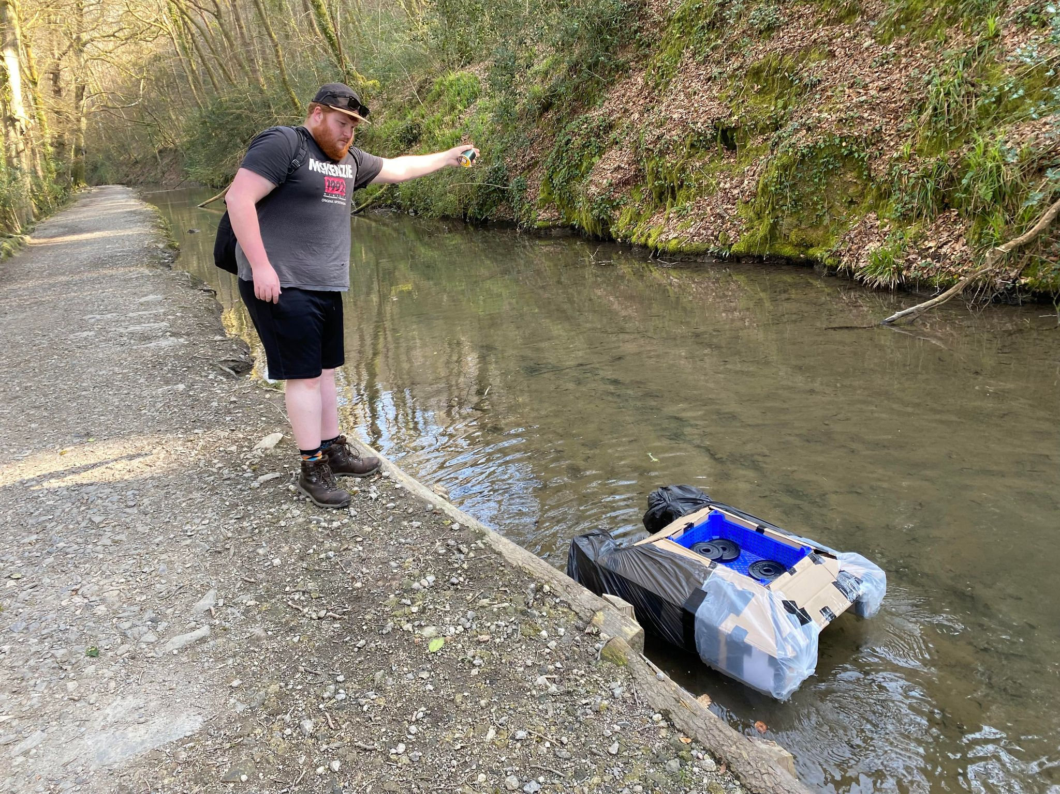
Initial Prototyping
Starting using milkshake bottles
Moved onto larger full scale prototypes

Slide 8
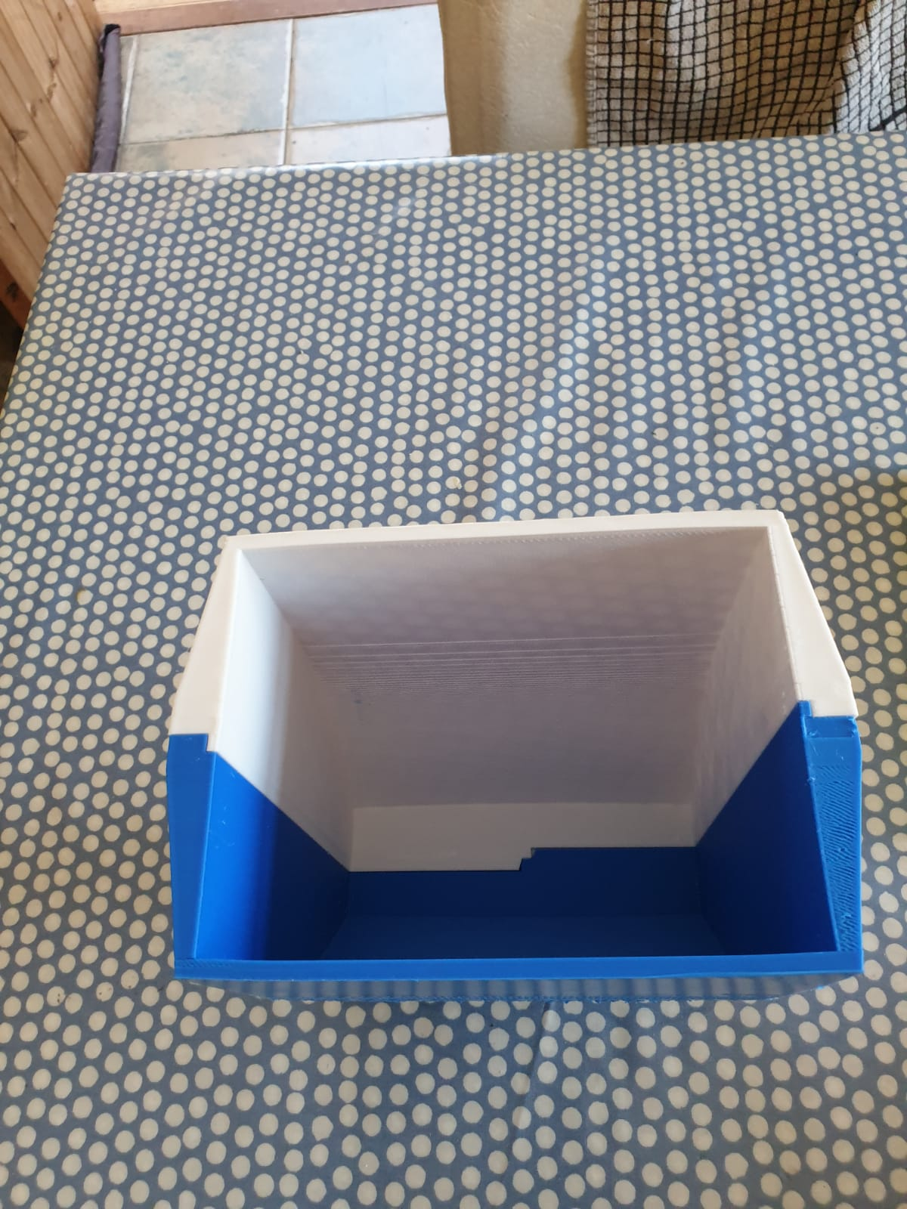
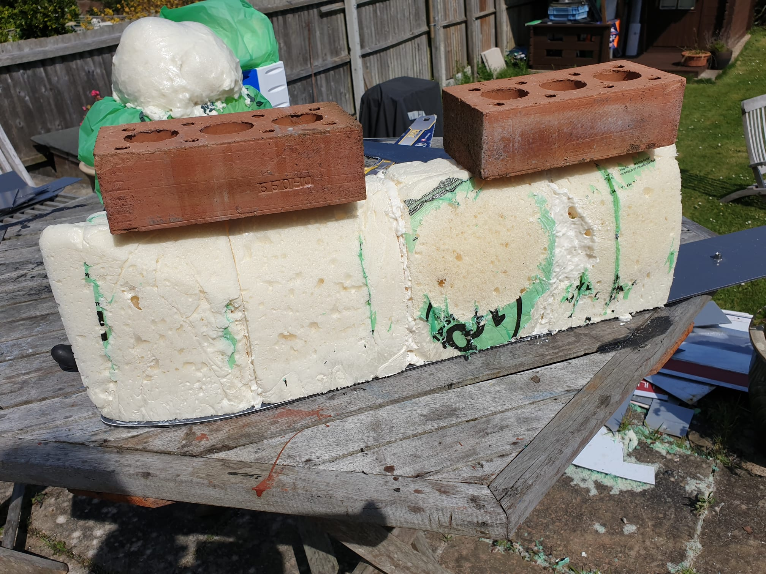
Finalised Design - Boat
Expanding Foam Hull Covered in Fiberglass and Epoxy
Base Plate made from polycarbonate sandwiched between aluminium sheets

Slide 9
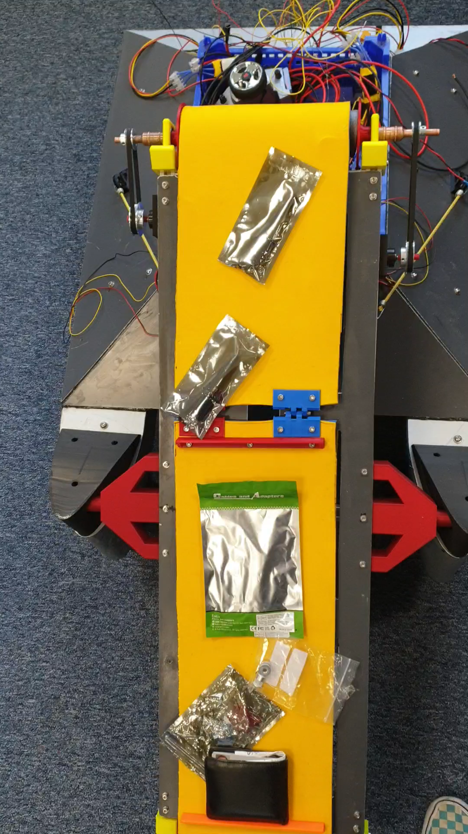
Conveyor
Aluminium Extrusion Frame
Polycarbonate sandwiched aluminium top plate
3D printed fixtures
Copper Pipe Rollers
Roll Mat Belt
3D printed Holders

Slide 10
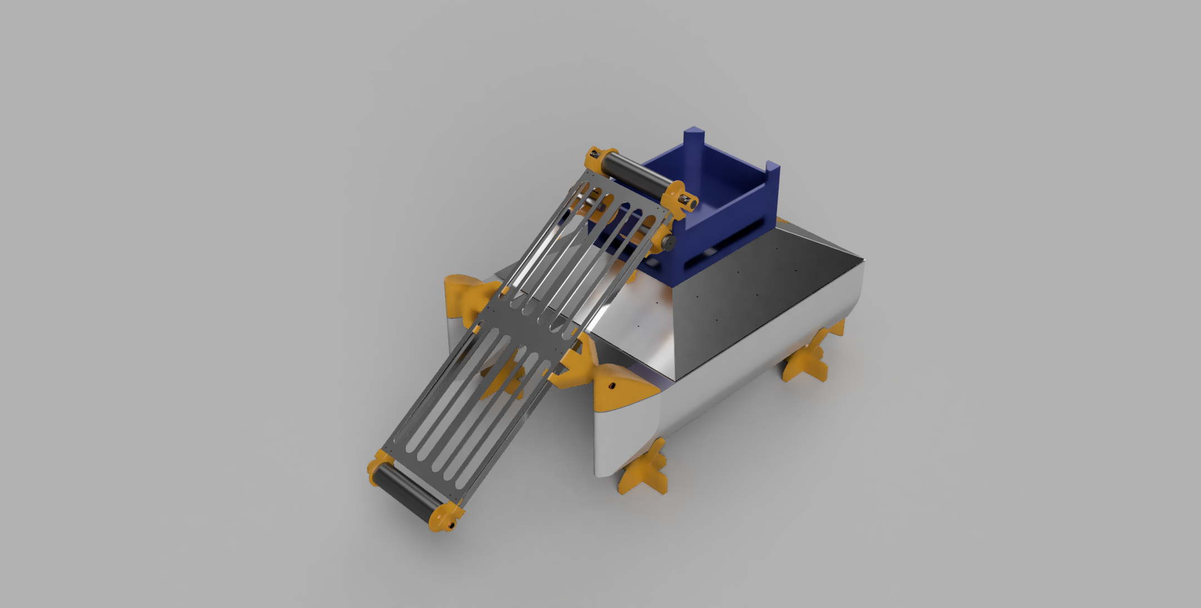
Finalised Design
Approx. 15-20Kg
Buoyancy of over 40Kg
Fully Waterproof
Litter Collection Basket
Conveyor attached on pivoting mount
Filtered water return

Slide 11
Software Design
Controller
Receiver

Slide 12
What were the issues that needed solving with software?
Craft Needs Controlling Remotely
Transmission Codes
Complex Control system
Conveyor Belt
Drive Systems
Battery Management
Litter Collection Box Capacity

Slide 13
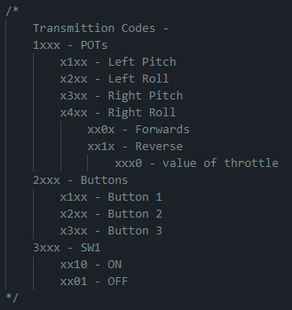
Transmission Protocol
Custom Transmission Protocol
Designed for the hardware used in this project
Expandable for more hardware

Slide 14
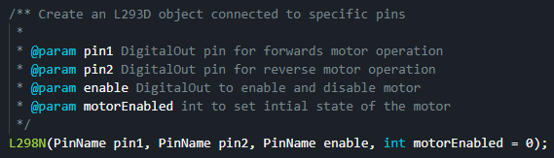
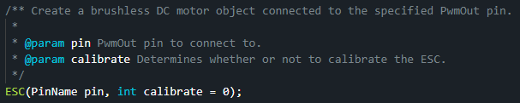
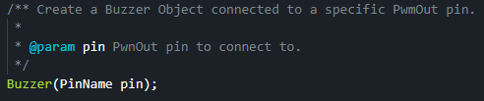
L298N Library
Software Libraries
Used to control the Conveyor Motors
ESC (Electronic Speed Controller) Library
Used to control the Brushless Drive Motors
Buzzer Library
Used to controller the onboard buzzer

Slide 15
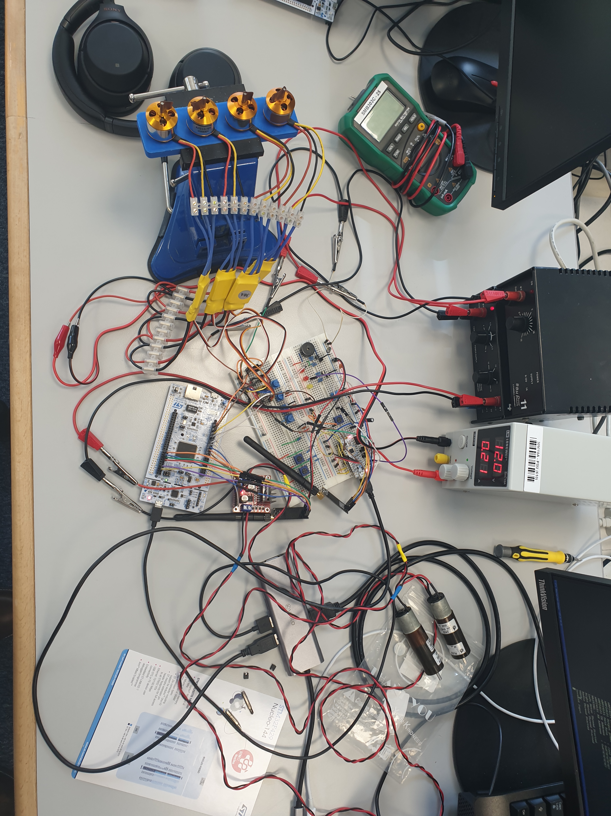
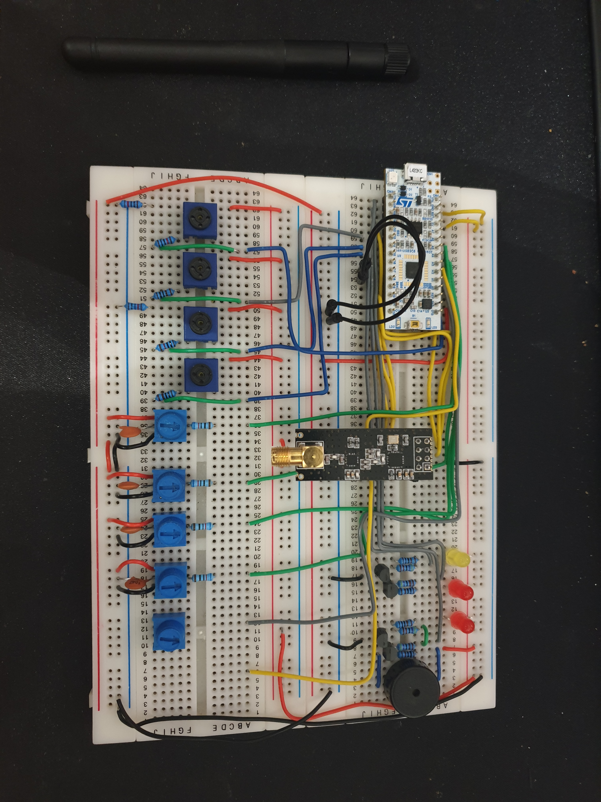
Software Testing

Slide 16
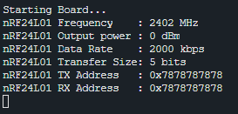
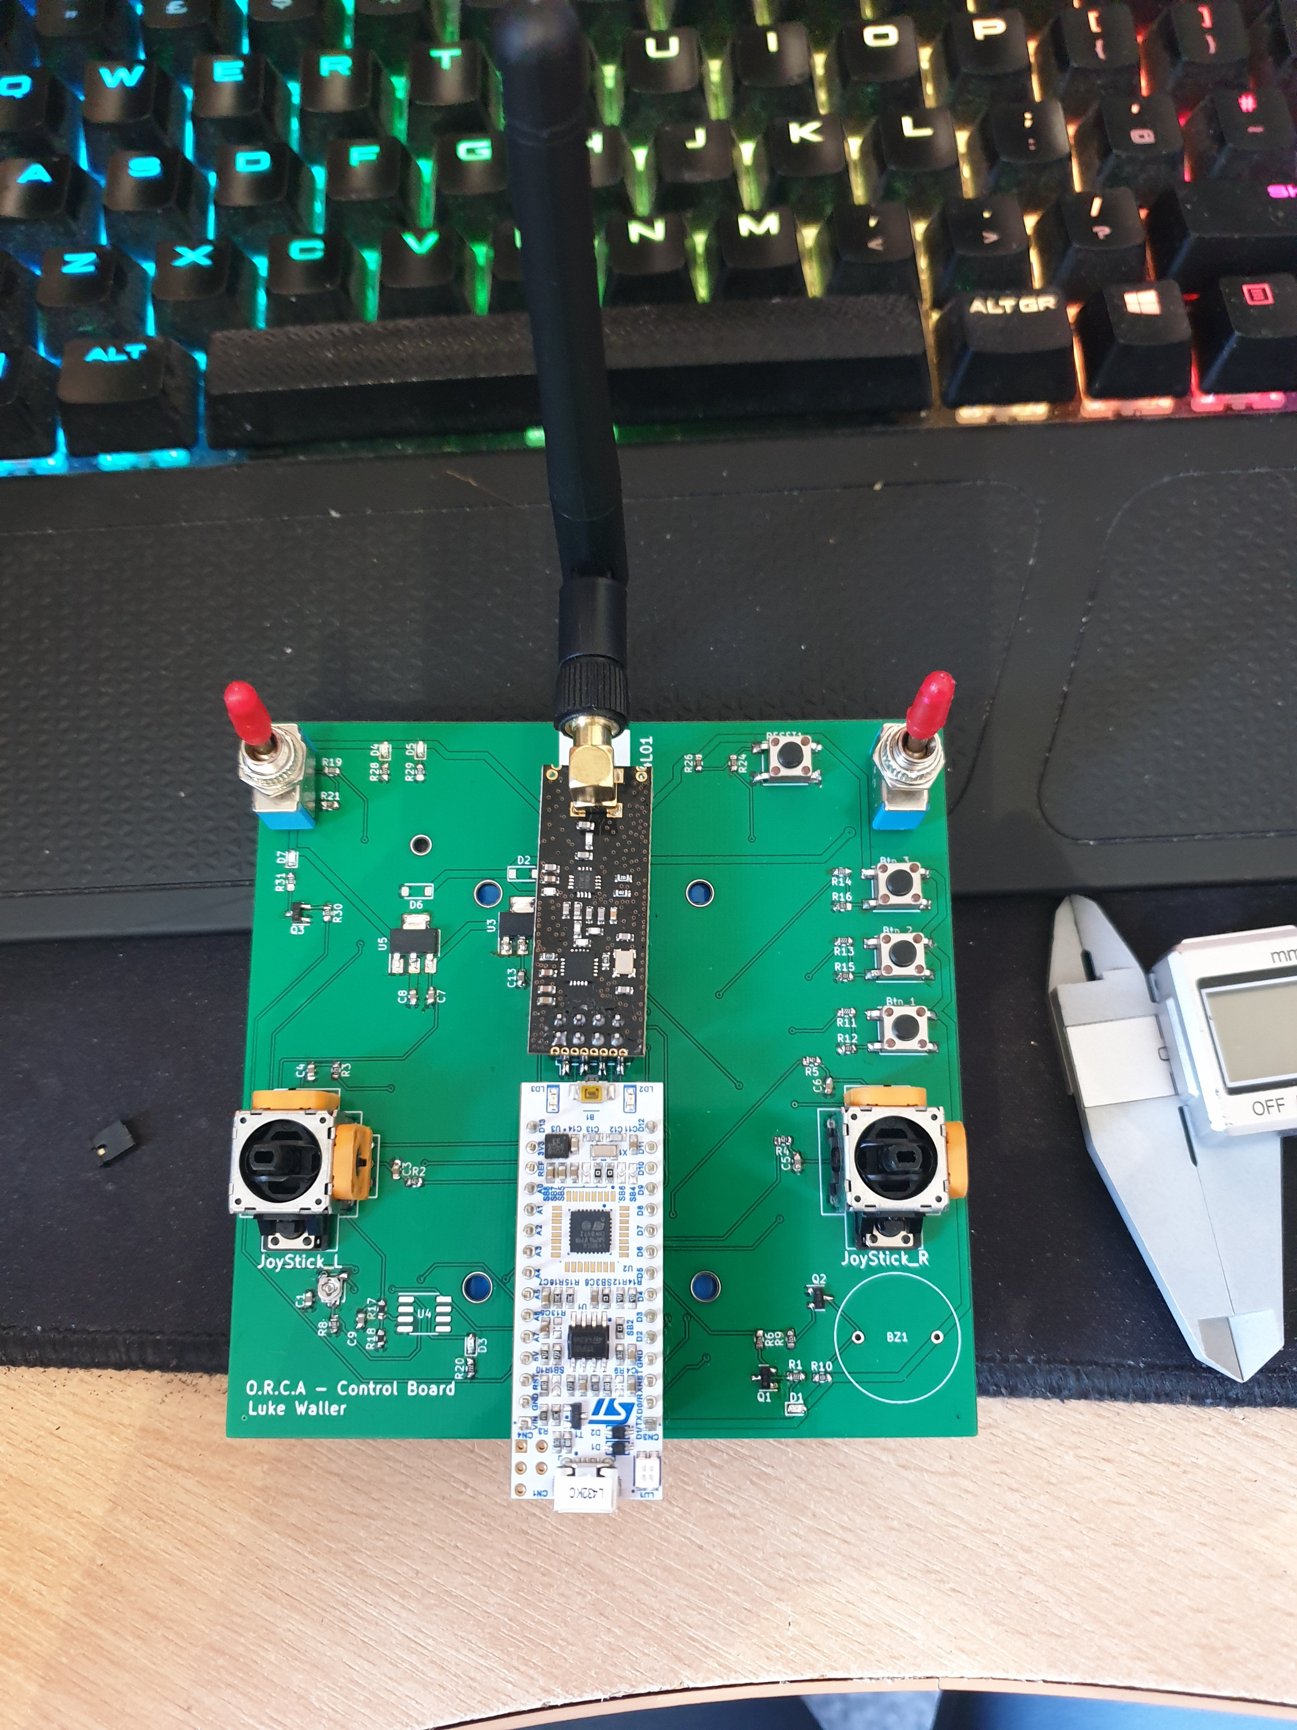


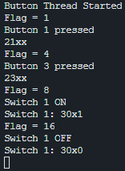
Controller
NUCLEO-L432KC
2 Joysticks
1 SPDT Switch
3 Push Buttons
Battery Monitor Chip
nRF24L01 RC Module

Slide 17
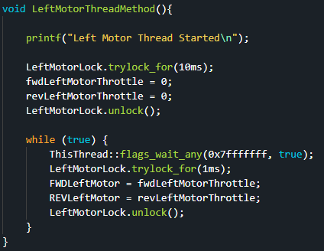
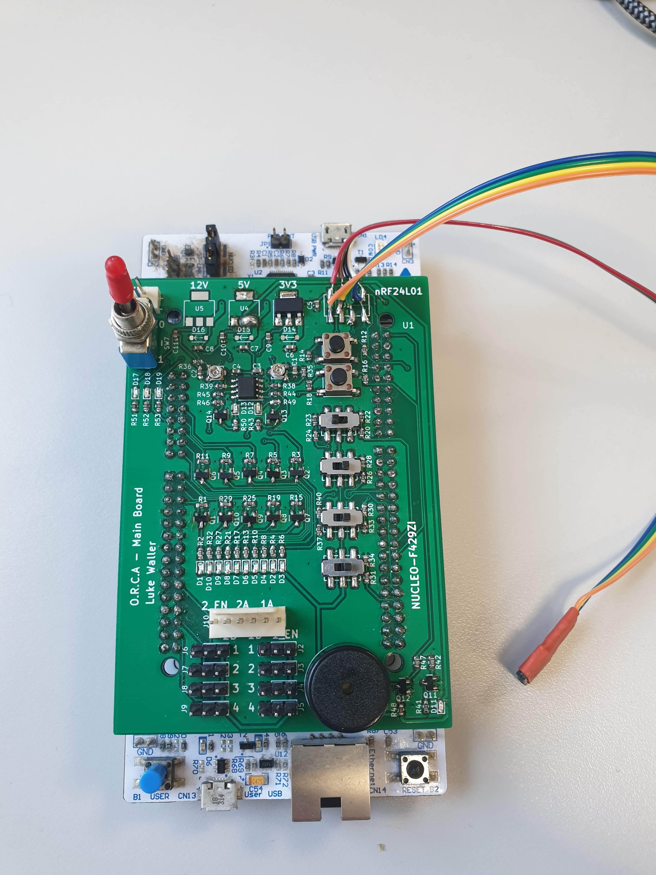
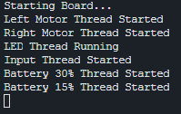
Receiver
NUCLEO-F429ZI
4 BLDC motors
4 IR Sensors
Buzzer
10 Onboard LEDs
Battery Monitor Chip
2 Push Buttons
4 Slide Switches
nRF24L01 RC Module

Slide 18
Issues/Challenges
nRF24L01 - intermittent connection issues
Hardware took longer to construct than expected
Hard to get Conveyor Belt tracking straight
Availability and Lead Times of Parts

Slide 19
Savings and Benefits of O.R.C.A
Cleaning Litter out of the sea to help with pollution
Cheaper than alternative solutions ~£200 vs. £19500

Slide 20
Future Developments
Autonomous Litter Tracking
Automatic environment mapping using GPS and LiDAR
Real Time Diagnostics and Management

Slide 21
Acknowledgements
Peers
Project Supervisor – Ian Howard
Labs Technicians

Slide 22
Thank you for watching

